Slide 1
SCORING WEB APPLICATION use case by H & R Block
By
Aishvwarya Iyer
Gayathree Iyer
Sruthi Gelivi
Pranathi Gopidi

Slide 2
INTRODUCTION
This application can be used by the future hackathon judges to evaluate the participant’s performance based on the following criteria:
User Experience, Innovation, Collaboration, Originality, Code quality, Design, Functionality and Integration of technology.
FEATURES:
Both judge and admin can login separately wherein judge has to register before he is allowed to login.
Judges can evaluate, give comments, update the scores and comments.
All scores, comments, team names will be stored in MongoDB database.
Admin can add and delete the teams.
Bar Chart visualization of final scores for each team and results can be accessed by both the users.
ADVANTAGES:
User friendly interface
Good visualization

Slide 3
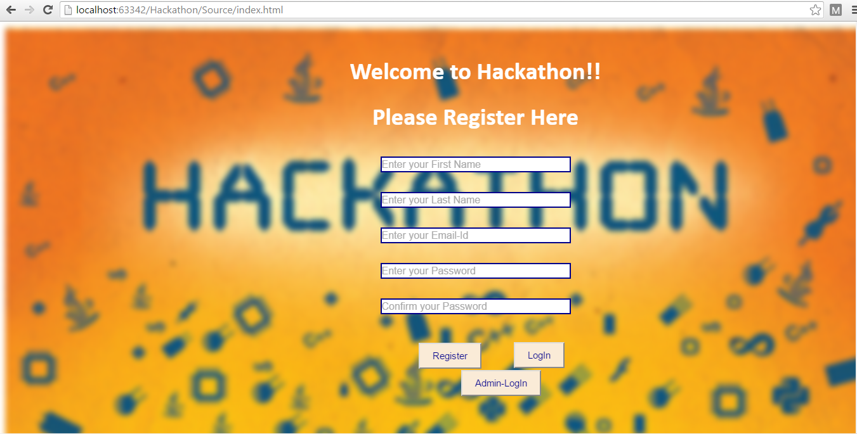
REGISTRATION PAGE FOR JUDGES

Slide 4
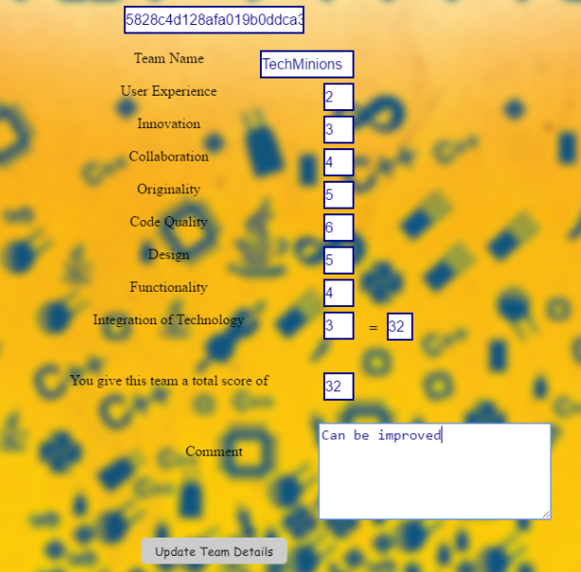
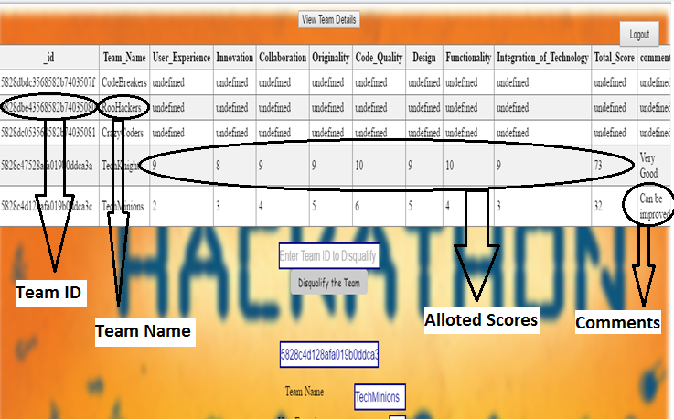
UPDATE SCORES, VIEW TEAM DETAILS, DISQUALIFY

Slide 5
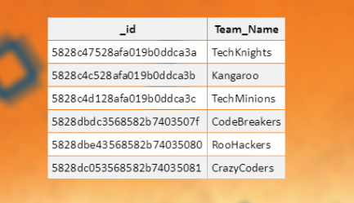
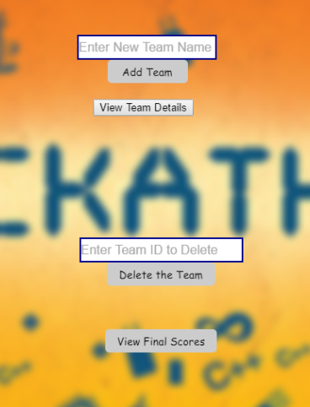
ADMIN FUNCTIONALITIES

Slide 6
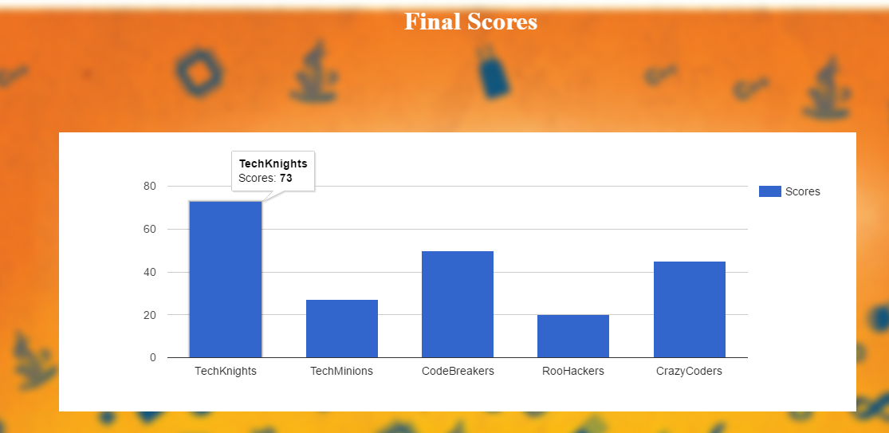
RESULTS PAGE VIEWED BY BOTH THE USERS

Slide 7
THANK YOU

